Slide 1
ELEMENTARY STATISTICS, BLUMAN
Levels of Measurement
© 2019 McGraw-Hill Education. All rights reserved. Authorized only for instructor use in the classroom. No reproduction or further distribution permitted without the prior written consent of McGraw-Hill Education.

Slide 2
Objectives for this PowerPoint
Define and learn to identify
The nominal level of measurement
The ordinal level of measurement
The interval level of measurement
The ratio level of measurement

Slide 3
Definition – Nominal Level
The nominal level of measurement classifies data into mutually exclusive (non-overlapping) categories in which no order or ranking can be imposed on the data.
The cars in a parking lot can be classified according to their color. There might be red, blue, green, or silver cars in the lot. But no ranking or order can be imposed on the variable “color.”
Classifying residents according to zip codes is also an example of the nominal level of measurement. Even though numbers are assigned as zip codes, there is no meaningful order or ranking.

Slide 4
Definition – Ordinal Level
The ordinal level of measurement classifies data into categories that can be ranked; however, precise differences between the ranks do not exist.

Slide 5
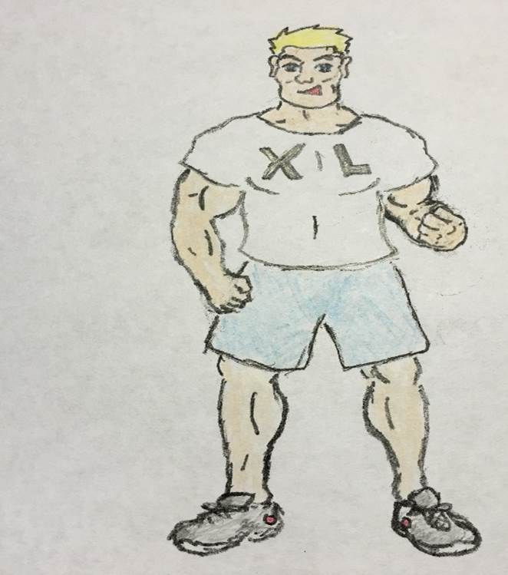
Example - Ordinal Level
T-shirt size is an example of the ordinal level of measurement.

Slide 6
Definition – Interval Level
The interval level of measurement ranks data, and precise differences between units of measure do exist; however, there is no meaningful zero.
IQ is an example of the interval level of measurement. There is a meaningful difference of 1 point between an IQ score of 109 and an IQ score of 110. But there is no meaningful zero to this scale as IQ tests do not measure people who have no intelligence.

Slide 7

Example – Interval Level
Temperature of a jumping frog is another example. There is a meaningful difference of 1˚F between a temperature of 98.6˚F and 99.6˚F. But 0˚F does not imply that the frog has no temperature.

Slide 8
Definition – Ratio Level
The ratio level of measurement possesses all the characteristics of interval measurement, and there exists a true zero. In addition, true ratios exist when the same variable is measured on two different members of the population.
If one person has 200 Instagram followers and another person has 100 followers, then not only is there an interval difference of 100 followers, but we can also state the relationship between them as a ratio of 2 to 1. Stated another way, the first person has twice as many followers as the second person. There is also a meaningful zero. If the value of the variable is zero, it implies that a person has no Instagram followers.

Slide 9
Examples
Classify each of the following according to level of measurement
Points scored by basketball players in a game
Time of day
Birth city for a sample of students
Level of agreement on a survey

Slide 10
Example 1 (1)
Points scored by basketball players in a game
The data values can be ordered
Interval differences exist between the data values
True Ratios exist between data values
There exists a significant zero
10 points is less than 20 points
20 points minus 10 points = 10 points
20 points/10 points = 2 to 1 ratio
Zero points implies that a player did not score

Slide 11
Example 1 (2)
Points scored by basketball players in a game is an example of Ratio Level of Measurement.

Slide 12
Example 2 (1)
Time of day
Data values can be ordered
Interval differences exist between the data values
True ratios do not exist between the data values
There does not exist a true zero
2:30 comes before 5:00
There is a measurable span of 2.5 hours between 2:30 and 5:00
It cannot be stated that 5:00 is twice as late as 2:30
If some requested the time, the reply would never be “zero”

Slide 13
Example 2 (2)
Time of day is an example of Interval Level of Measurement

Slide 14
Example 3 (1)
Birth city for a sample of students
No ranking or order can be placed on the data
Walla Walla, Washington Saskatoon, Saskatchewan
Crapstone, England

Slide 15
Example 3 (2)
Birth city is an example of Nominal Level of Measurement

Slide 16
Example 4 (1)
Level of agreement on a survey
Data can be ranked in order
No interval difference can be measured between the data values
Strongly Disagree, Disagree, Neutral, Agree

Slide 17
Example 4 (2)
Level of agreement on a survey is an example of Ordinal Level of Measurement

Slide 18
Summary
In this PowerPoint we defined nominal level of measurement, ordinal level of measurement, interval level of measurement, and ratio level of measurement.

